Slide 1
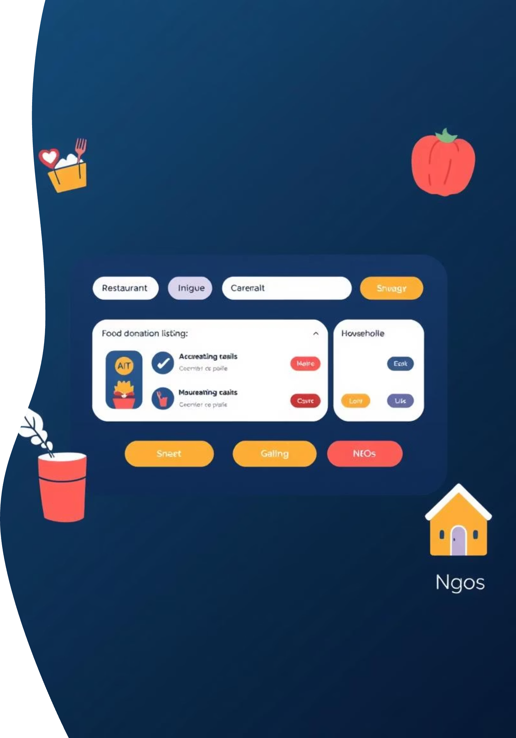
Meal Bridge:From leftovers to lifelines
A new website enabling restaurants & households to donate surplus food directly to NGOs, cutting out intermediaries and maximizing impact.

Slide 2

Problem Statement
Every single day, tons of perfectly edible food is discarded in restaurants, homes, and cafeterias — not due to spoilage, but due to the absence of a simple, efficient system to track and redirect it. While millions go hungry, nutritious meals end up in landfills. Our mission is to harness technology to track, analyze, and reroute this excess food to those who need it most — bridging the tragic gap between waste and want.
This platform addresses the critical gap between food surplus and those in need, aiming to streamline the process and reduce waste.

Slide 3




User Personas
Restaurant Owner
Household Donor
Wants to donate surplus food quickly and easily after closing, ensuring minimal waste and positive community impact.
Occasional donor with leftover event food or pantry items, seeking a simple, direct way to contribute.
NGO Coordinator
Platform Admin
Needs reliable, real-time access to food donations to distribute to beneficiaries, minimizing logistical overhead.
Manages listings, verifies users, and ensures the smooth and secure operation of the donation ecosystem.

Slide 4
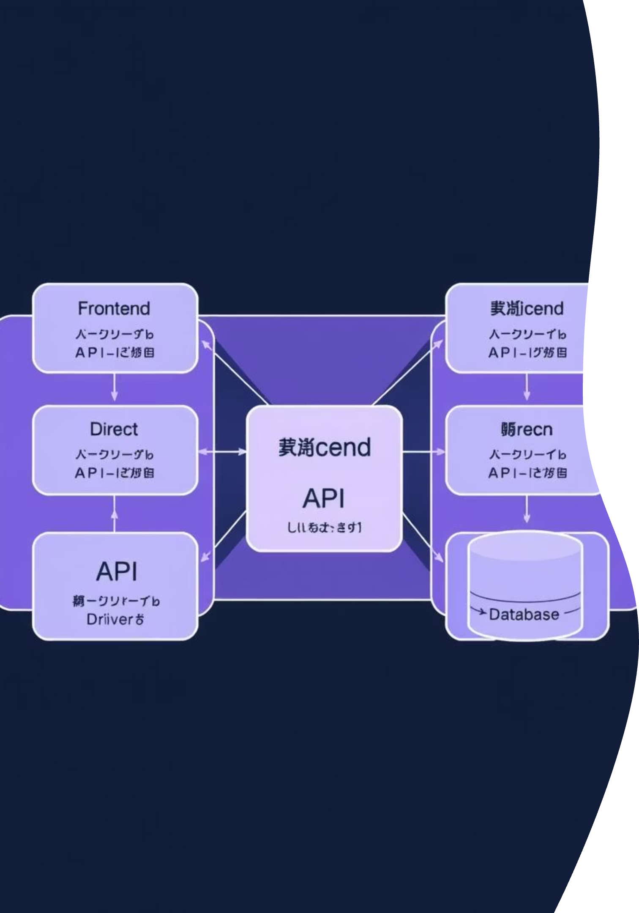


System Architecture Overview
Frontend & Backend
API & Authentication
Responsive web app with a dark-themed UI/UX, supported by a secure backend database for user profiles and food listings.
An API layer handles uploads, notifications, and real-time updates. Role-based authentication ensures secure access for donors, NGOs, and admins.
Crucially, there is no driver logistics module; NGOs coordinate pickups directly, simplifying the supply chain.

Slide 5
Presentation Outline
1
Problem Statement
2
User Personas
3
System Architecture
4
Proposed Solution
5
MVP Features
6
Open Innovation & Impact
7
Future Scope & Vision

Slide 6
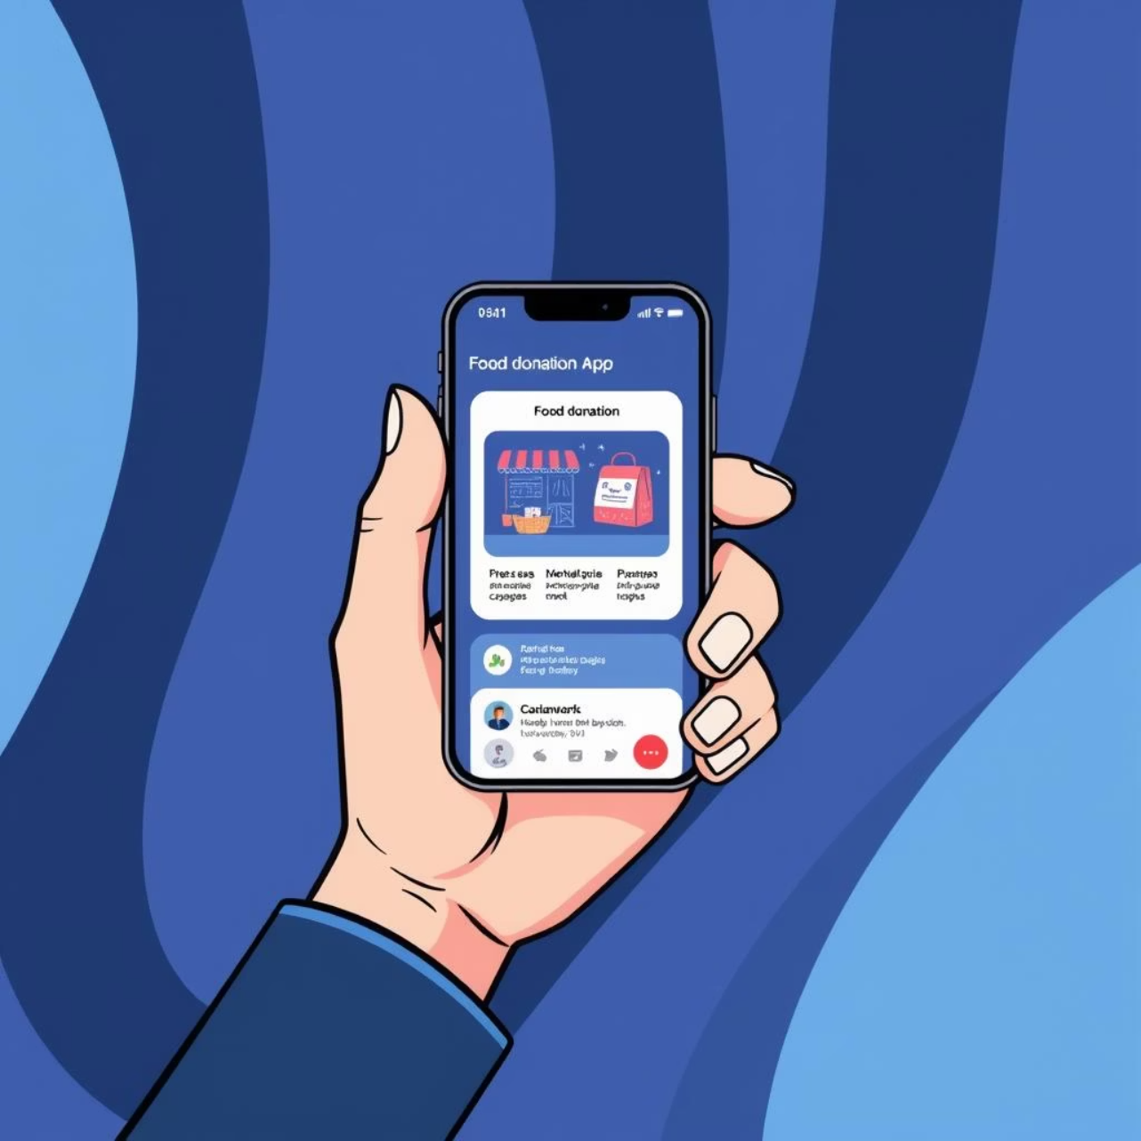

Proposed Solution
Our platform provides a centralized hub for direct food donation uploads. It offers real-time matching of surplus food with registered NGOs, ensuring efficiency.
Notifications alert NGOs for immediate acceptance, eliminating the need for third-party drivers and significantly reducing delays and costs. Data tracking ensures transparency and measurable impact.

Slide 7
MVP Features
User Registration & Login
Food Donation Upload
NGO Dashboard
Role-based access for donors and NGOs, ensuring secure and personalized experiences.
Intuitive forms for donors to list surplus food with essential details and photos.
A dedicated interface for NGOs to view available donations and accept them directly.
Automated Notifications
Basic Analytics
Real-time alerts for new donations and acceptance, streamlining communication.
Simple insights into donation volume and impact to track initial progress.

Slide 8









Open Innovation & Impact
Community Participation
NGO Empowerment
Fosters engagement in reducing food waste across all sectors.
Provides direct, reliable access to essential food resources.
Reduced Carbon Footprint
Transparent Data
Minimizes transport needs, contributing to environmental sustainability.
Builds trust and enables continuous process improvement.

Slide 9


Future Scope & Vision
Expansion & Integration
Advanced Capabilities
Mobile app for on-the-go donations.
AI-powered matching and predictive analytics for demand/supply.
Integration with food safety authorities.
Expansion to food banks, shelters, and volunteer coordination.
Gamification and rewards to boost donor engagement.

Slide 10
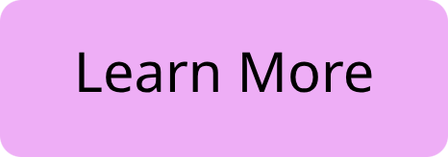




Conclusion
A scalable, sustainable solution for a hunger-free future.
This innovative platform streamlines food donation, empowering restaurants, households, and NGOs to fight hunger directly. Join us in creating a future where no food goes to waste.

